Slide 1
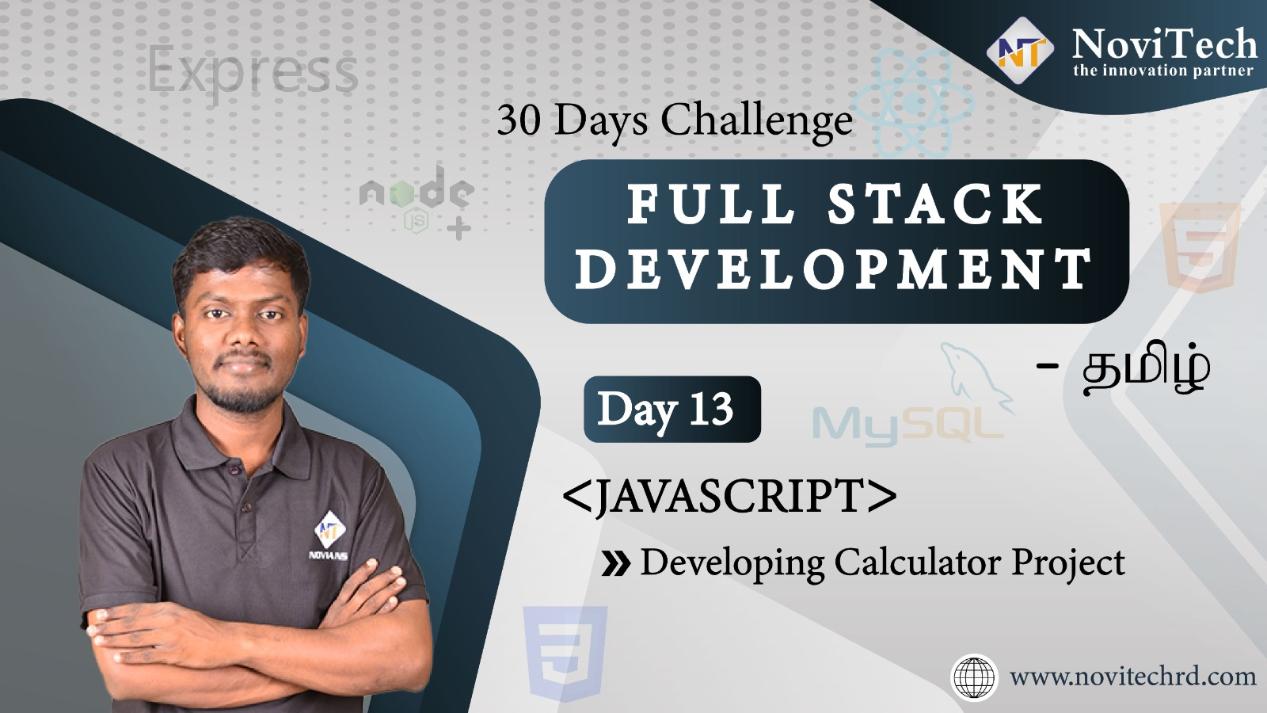

Slide 2

Announcement
ATTENDANCE LINK will be shared in between session
Minimum 28 DAYS Attendance required to receive your
FREE E-CERTIFICATE

Slide 3
Prerequisites
Laptop with Internet Connection
No Prior Knowledge is required
Note & Pen

Slide 4
CALCULATOR
The goal is to design a user-friendly interface that allows users to perform basic arithmetic operations such as addition, subtraction, multiplication, and division.

Slide 5
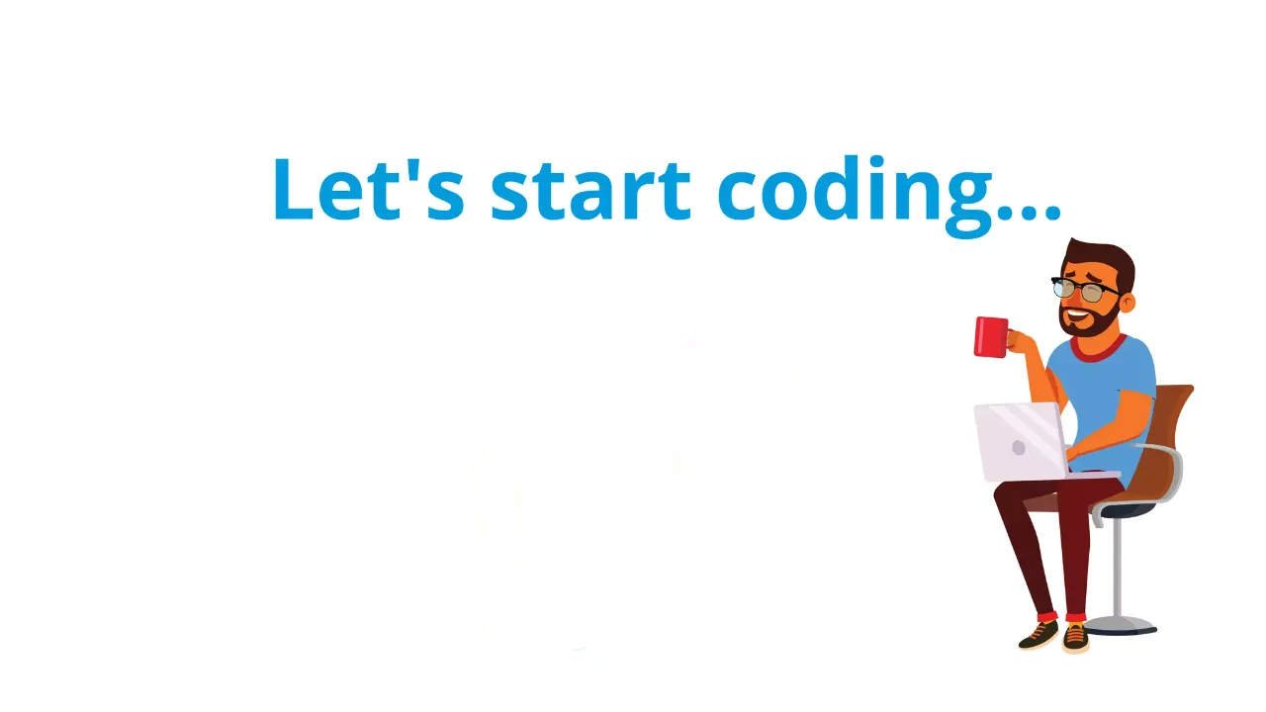

Slide 6



Slide 7

wonder word
Happy

Slide 8




THANK YOU☺
JOIN WhatsApp community
novitechresearchanddevelopment

Slide 9
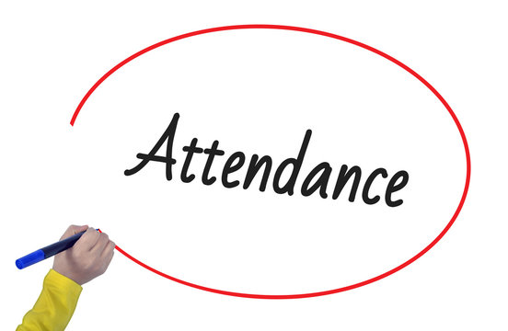
Post Your Attendance

Slide 10


